Slide 1
Buying a House
Ahmuth Bin Omar
Program Coordinator - Wunan Foundation

Slide 2
Journey of a home buyer

Slide 3
A pathway to home ownership
Steady job (for at least 12 months)
No or minimal other debt (including debt like Afterpay and Zipay!)
Deposit: House value x at ideally 10%, minimum 5%
Good banking conduct

Slide 4
Expression of interest
Meeting with the bank
Your credit score
Application for a mortgage loan
Approval/Rejection
Settlement contract

Slide 5
Stakeholders
KeyStart
IBA – Indigenous Business Australia
Eligibility Requirements | Loan Types | Features
Over 18 years of age, Australian citizen or permanent resident, at least one applicant must be of Aboriginal or Torres Strait Islander descent, capacity to meet housing loan repayments, and intend to live in the property as your main place of residence | Home loans | Low deposit requirements, low interest rates, additional finance assistance for other fees associated with homebuying, such as conveyancing costs, property valuations, and building and pest inspections, as well as for home improvements
Eligibility Requirements | Loan Types | Features
You are over 18 years old, don’t already own a home or land, looking a home to live in - not to rent. Australian citizen or permanent resident. Live in WA and want to buy or build a home here | Full ownership Shared Ownership Home Loan | Low deposit options, no lender’s mortgage insurance, dedicated Aboriginal home ownership team, shared ownership loan allows the Housing Authority to co-own a share of the property with you, lowering your loan amount

Slide 6
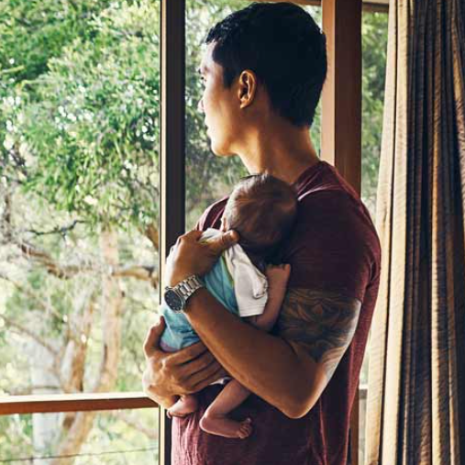
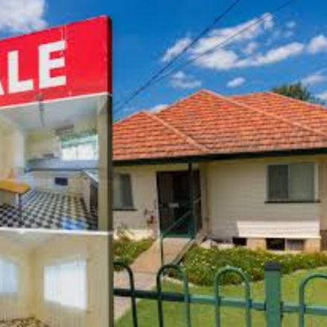
Choose your house
Location – next to the water, view of mountain
SIZE – 3X2, 4X2..
Your finances – within your budget
Start small!

Slide 7
Benefits of buying your own house
Financial security
Investment (good use of your money) – provides a return (interest)
Legacy (for your family/community)
Equity to use for other assets (for example to buy a second house)

Slide 8
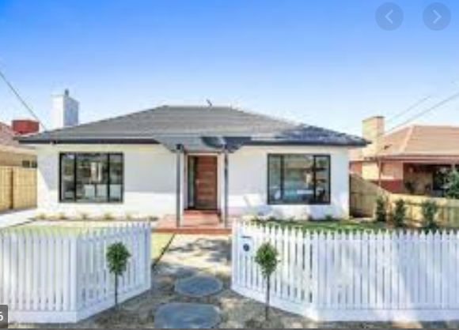
Risk of buying a house
Changes in the Housing Market
Losing your job
Can’t keep up with your payments

Slide 9
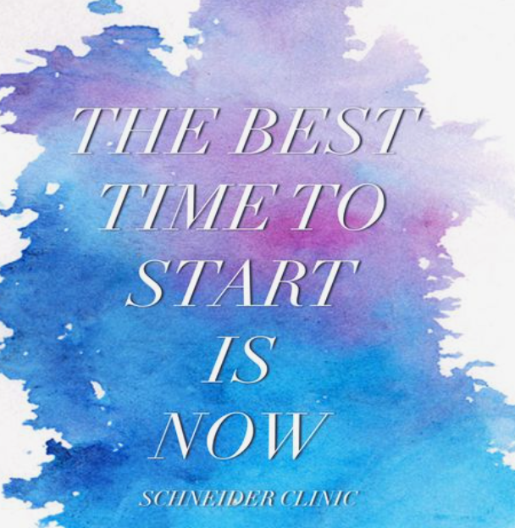
When to start?
Now!

Slide 10
Pathway to home ownership
Ahmuth Bin Omar
Program Coordinator - Wunan Foundation

